Slide 1
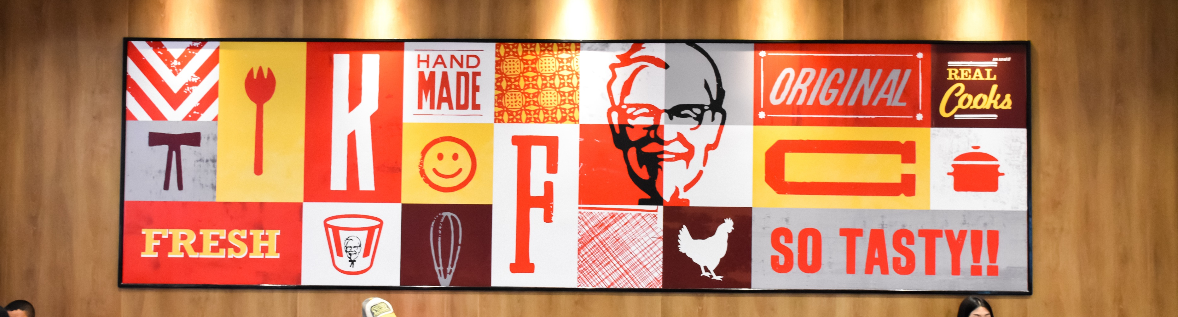








Fast Food
ProNoïa, major franchise partner of the KFC brand in France,
is financed to the tune of €85 million to accelerate its development
Fast Food
Context
Pierre TRITZ, President of ProNoïa, is a successful entrepreneur operating KFC franchised restaurants since 2013.
ProNoïa, whose head office is located in Pau (64), has, at the end of January 2023, 26 KFC restaurants in the South-West, Ile-de-France and Centre-East region, a number that has been growing strongly for 2 years, with the opening of about fifteen restaurants since mid-2021.
Relying on a motivated and experienced team, ProNoïa has demonstrated all its know-how in the development of franchised restaurants as well as in the financial management of restaurants and the group.
The French market continues to be a major growth segment for KFC, a brand specializing in chicken preparations, which has a growing market share and wishes to continue the network of territories and gain proximity to the French, by doubling its current fleet to reach 600 restaurants within 5 years.
ProNoïa, already KFC's 1st independent franchisee in France, aims to capture more than a third of the brand's growth over the next 3 years.
participated in the financing of the Corporation’s development
PRONOÏA’S COUNCIL
The growth of the KFC brand and the ProNoïa group is accompanied by the development of an ambitious CSR approach, focused in particular on reducing the carbon footprint in compliance with the Paris agreements, animal welfare with the signing of the European Chicken Commitment, eco-design of packaging, improving the nutritional qualities of recipes and employee well-being at work..
The operation
This new phase of ProNoïa's expansion represents a target of opening more than 33 restaurants by 2025.
Societex CF was commissioned exclusively by ProNoïa to assist it in structuring the transaction and seeking financial investors to ensure the continuity of its development in France.

Slide 2
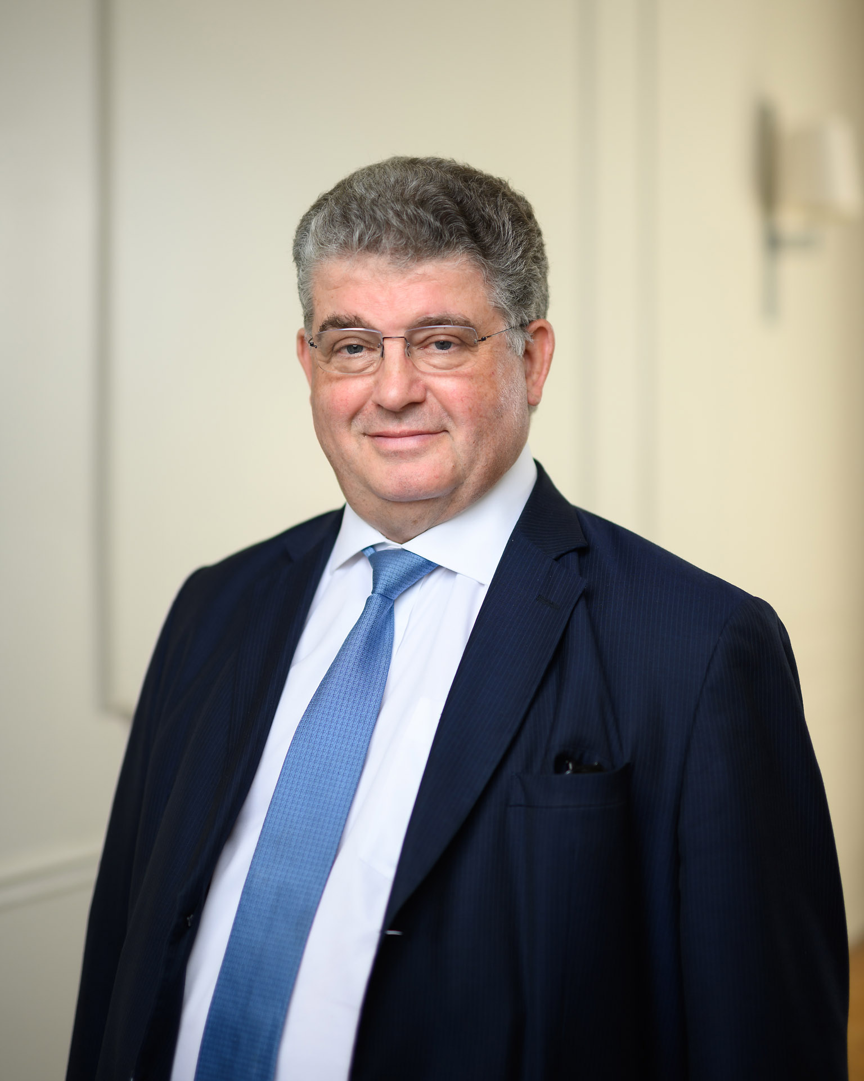
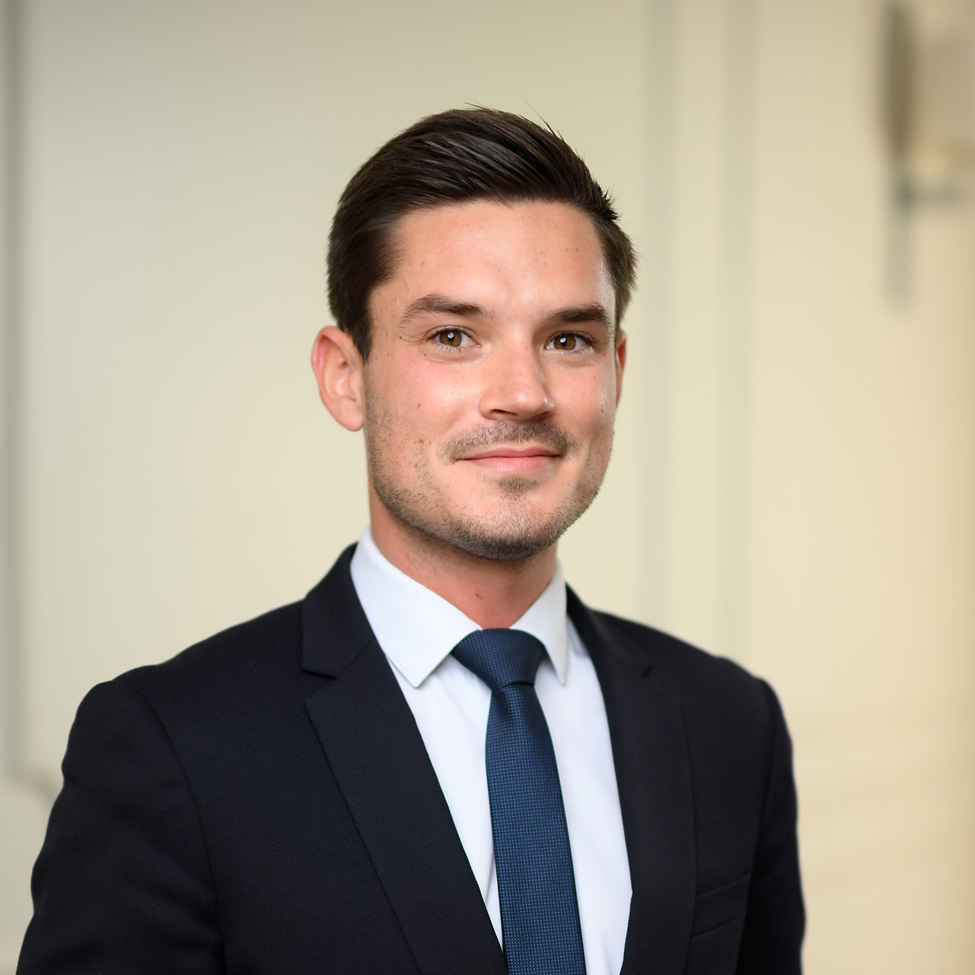
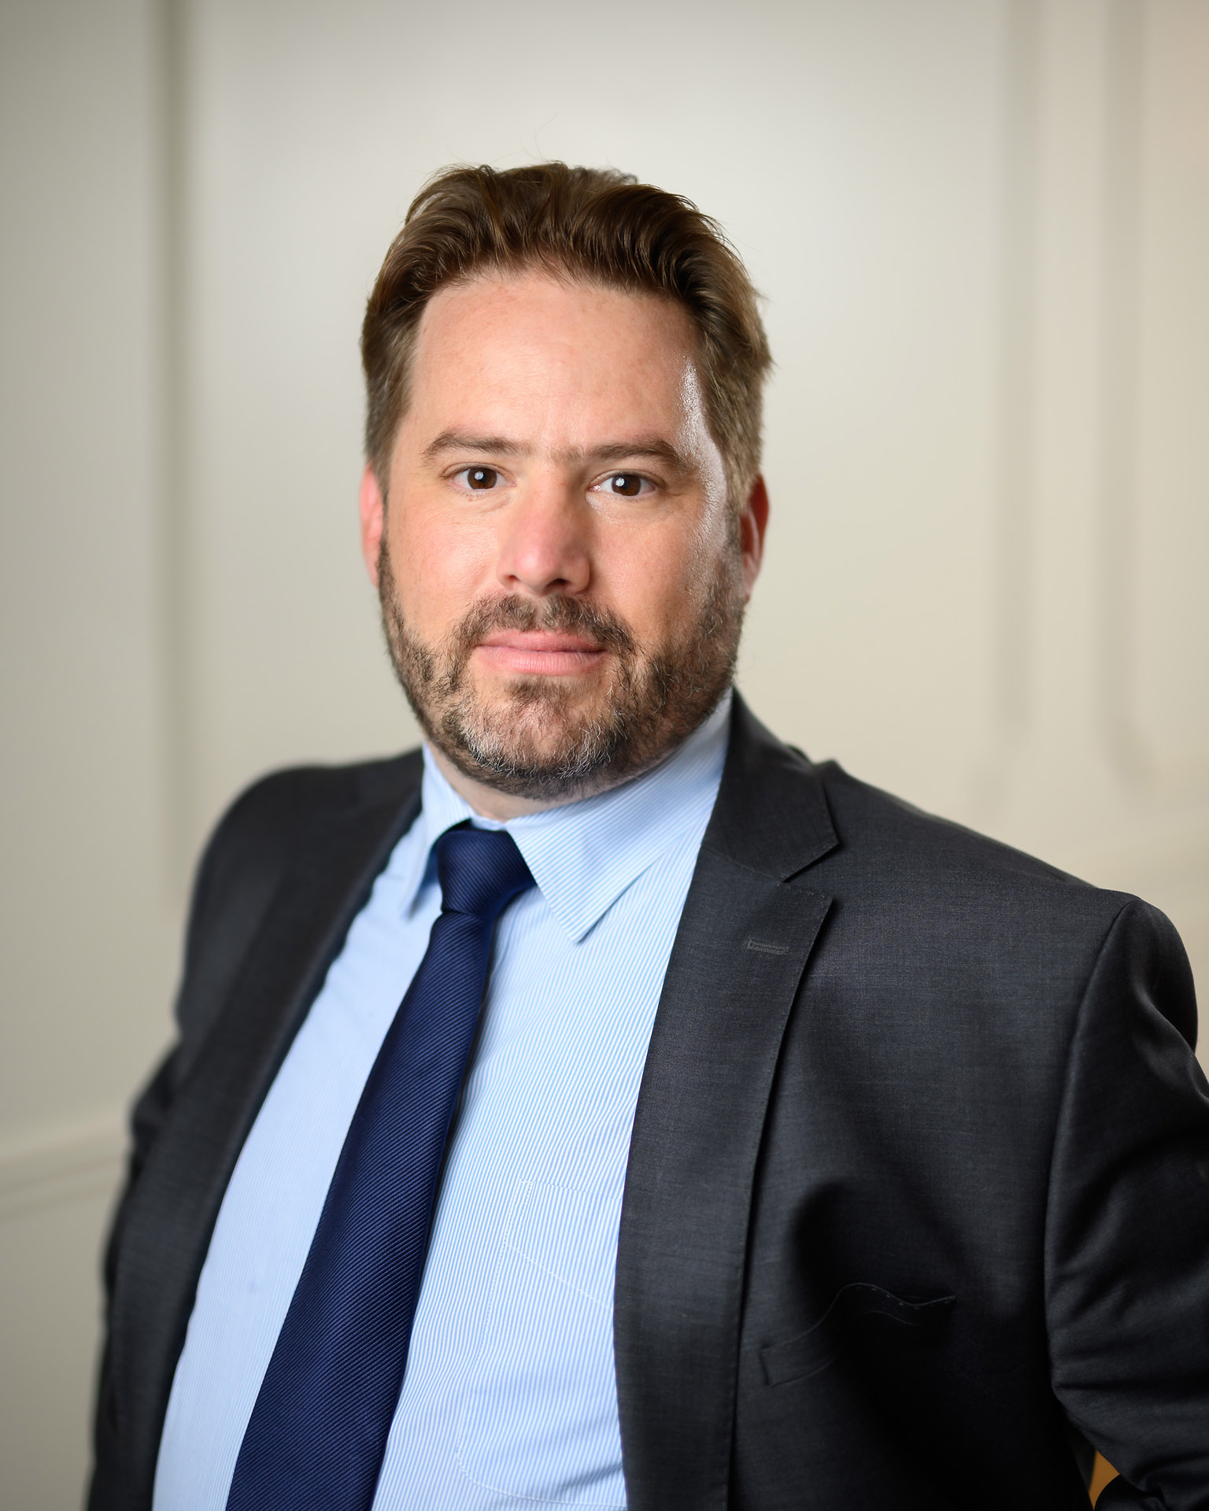
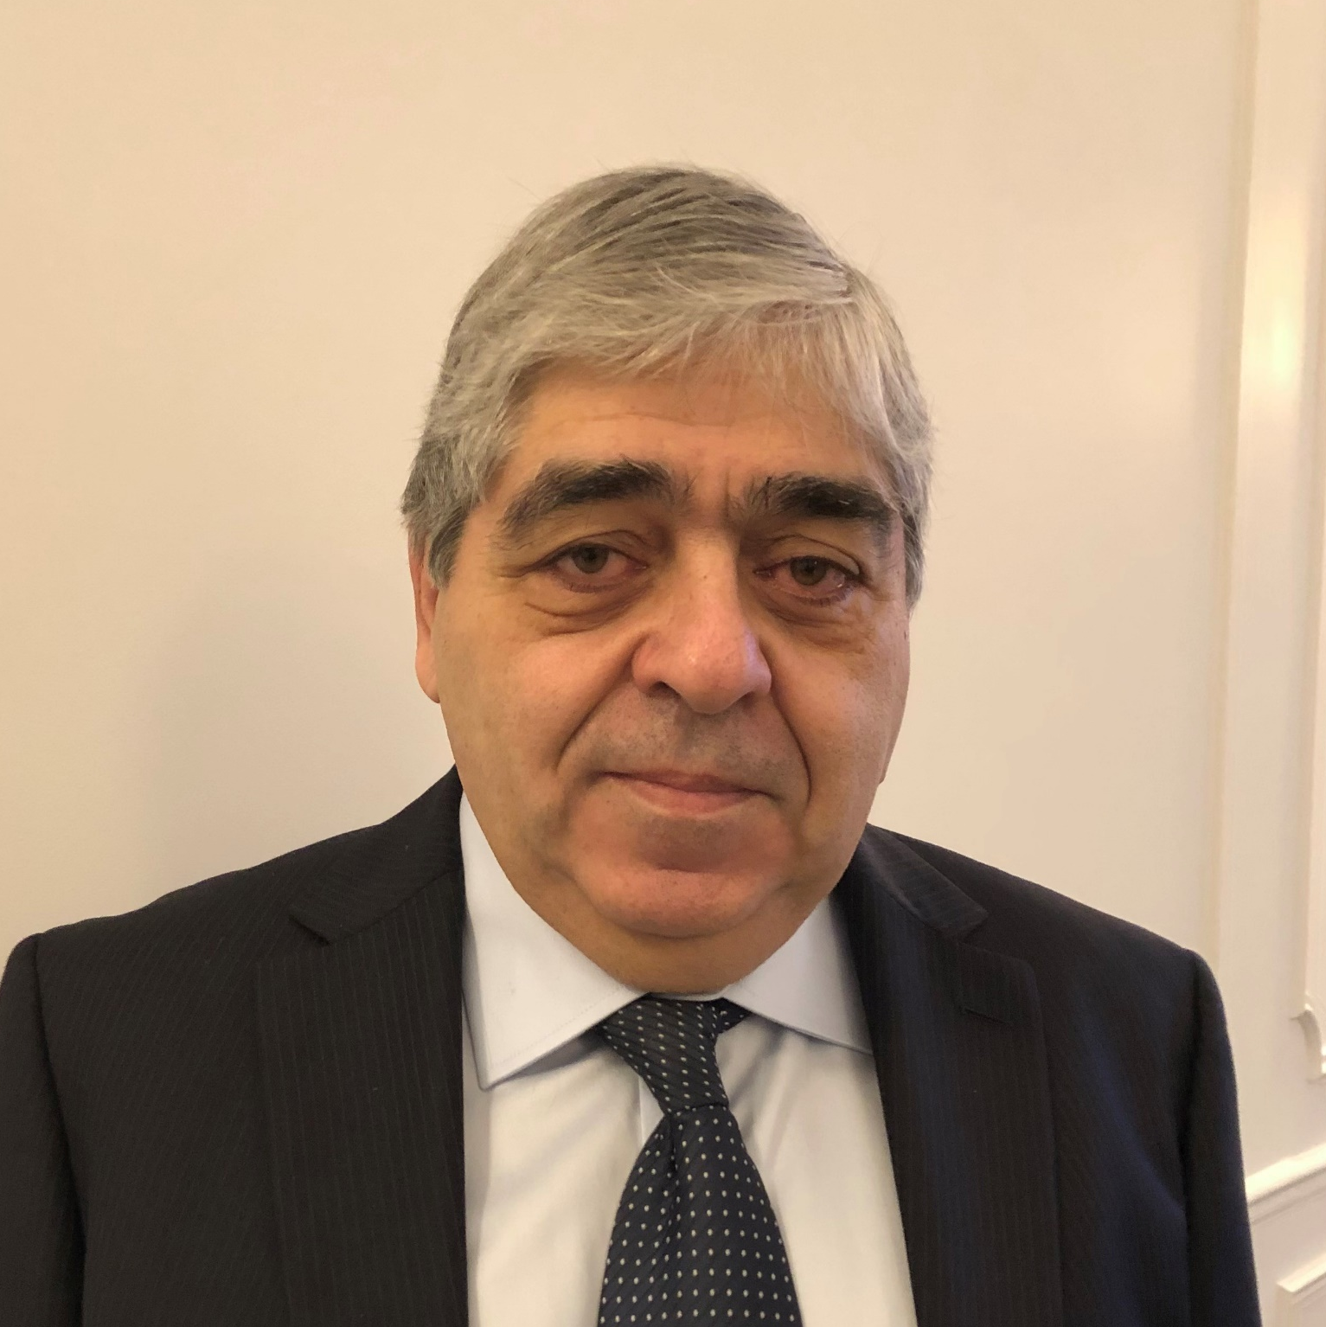
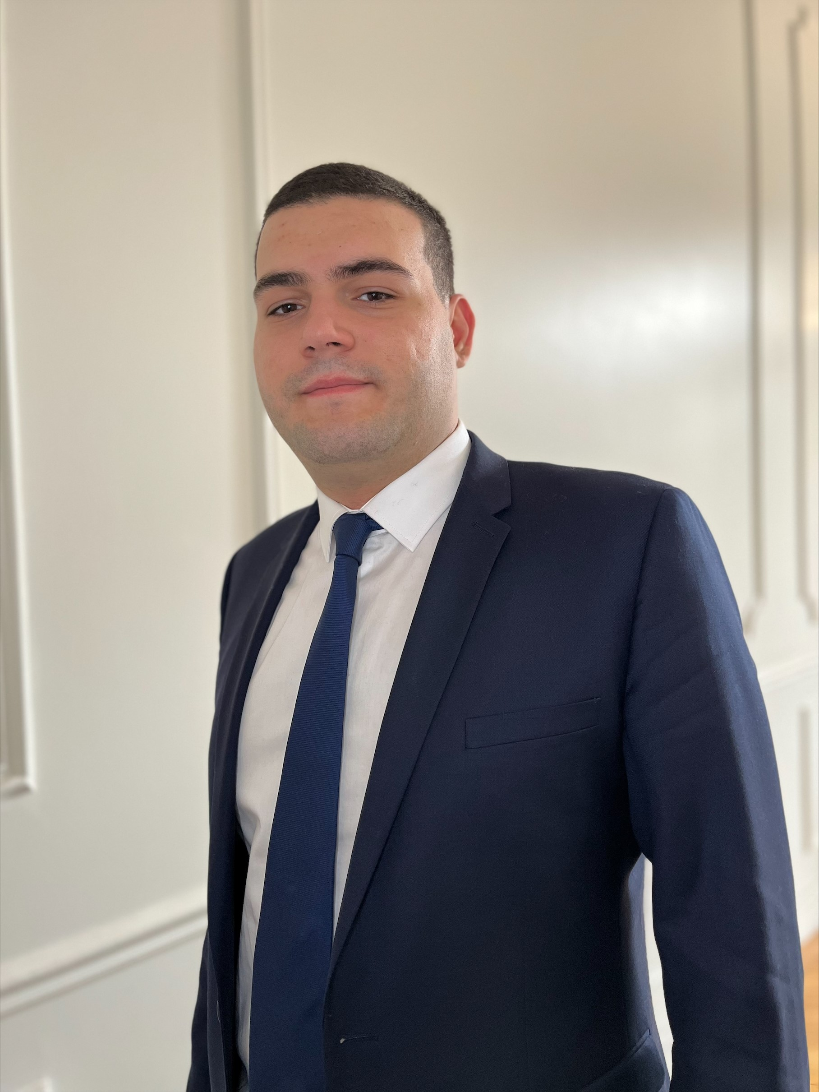
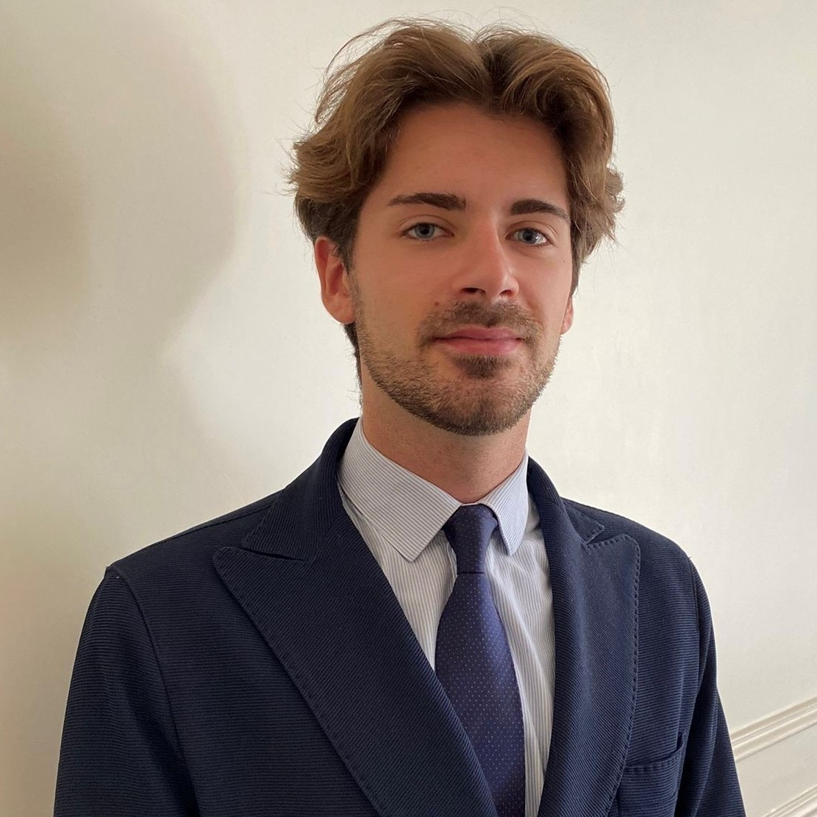
Restauration rapide
The financing of this operation is mainly provided by a pool of banks composed of Crédit Lyonnais, coordinator and co-arranger, La Banque Postale and Crédit Agricole Aquitaine, co-arrangers, and Crédit Agricole Pyrénées Gascogne and BNP Paribas as participants.
Cerea Partners, a leading player in financing in the agri-food value chain, is providing €15 million in the form of mezzanine financing.
Testimonials
Commenting on this transaction, Pierre TRITZ, President of ProNoïa, said: "ProNoïa was able to surround itself with the best advisors, the best financing players, to finance an ambitious development plan and contribute to the influence of the KFC brand in France. Beyond the purely financial aspect, we have managed to share values and a project that aspires to take our share of societal and environmental commitments that characterize sustainable growth."
Hubert LANGE, Associate Director, and Hugo FRADON, Investment Director at Cerea Partners, said: "We are delighted to invest in mezzanine to finance the development of the ProNoïa group, which has proven itself since the opening of its first restaurant in Pau in 2013 to become the first independent franchisee of KFC in France and today pursue an ambitious opening plan. We were convinced by the solid fundamentals of the group but also by the strong social values carried by Pierre TRITZ and his teams as well as by the CSR approach of the group and the brand, focused in particular on optimizing a carbon footprint already very favorable in its sector, improving recipes and ingredients and adopting best practices for respect for animal welfare."
SOCIETEX CF’s Team
Jean-Jacques VAURY
Deputy-Chairman
jean-jacques.vaury@societex.com
Clément MATELOT
Director
clement.matelot@societex.com
Thomas BEAURAIN
Chairman
thomas.beaurain@societex.com
Marc BENCHIMOL
Senior Advisor
marc.benchimol@societex.com
Ali DRISSI
Analyst
ali.drissi@societex.com
Amaury PERDRIAU
Analyst
amaury.perdriau@societex.com

Slide 3
Restauration rapide
Speakers
ProNoïa Company
ProNoïa (Pierre TRITZ, Jaques CORBIER, Laetitia DUARTE, Stéphanie ARBES)
Councils :
M&A Consulting : Societex (Jean-Jacques VAURY, Clément MATELOT, Thomas BEAURAIN, Marc BENCHIMOL, Ali DRISSI, Amaury PERDRIAU)
Lawyer : ADVEO Avocats (Emmanuel WIPLIER, Joséphine LALOUS)
Vendor Assistance : EY (Laurent CHAPOULAUD, Claire DELARBRE, Baptiste DAL POS, Tristan RABATEL, David KACHICH)
Mezzanine Funds
CEREA Partners – Private Debt (Michel CHABANEL, Hubert LANGE, Hugo FRADON)
Councils :
Investor Legal Advice and Legal, Tax and Social Due Diligence : De Pardieu Brocas Maffei (Jean-François POURDIEU, Sandra BENHAIM, Baptiste TIGAUD, Pierre-Alexis BIEHLER, Laura DELAS, Anne-Laure DROUET, Mickael AMMAR, Victoire MERCEY, Nicolas BRICAIRE, Benjamin GARRET, Vincent VILLE, Maria Sofia DE FELICE, Vincent MANIGOT, Victor DEHAN)
Financial due diligence : Mortier & Co (Olivier MORTIER, Boris CHEDIN, Alexis DROUIN, Grégoire LECLERC)
Senior Lenders
LCL (Ivan PIQUERAS, Christophe PERIGOIS, Nicolas FLAMICOURT)
La Banque Postale (Virginie DASCON, Michael PEDRO, Laurent VIGNEAUX)
Crédit Agricole Aquitaine (Pierre BREFFEILH, Romain GUERER)
Crédit Agricole Pyrénées Gascogne (Pascal LAMAIGNERE)
BNP Paribas (Nicolas DUREUIL, Florian GUYOT)
Council :
Lawyer : VOLT Associés (Alexandre TRON, Morgane LE GALLIC, Marianne PHANKONGSY)
Jean-Jacques VAURY
Deputy-Chairman
+33 (0)6 07 95 21 71
jean-jacques.vaury@societex.com
SOCIETEX is an independent investment bank created in 1952 and specialized in advising on business sales, acquisitions, fundraising, valuation and financial engineering in France and abroad..

